Slide 1
Online Food Ordering Application
Business Analyst Project Presentation

Slide 2
Agenda
- Problem Statement
- Objectives
- Business Scope
- Stakeholders
- Functional & Non-Functional Requirements
- User flow
- Use Case Diagram
- Flowchart
- Conclusion

Slide 3
Problem Statement
Customers face inconvenience due to fragmented food ordering methods, lack of real-time tracking, and payment failures. Restaurants and delivery partners struggle with order management and communication. A centralized solution is required.

Slide 4
Objectives
- Simplify food ordering via mobile app
- Provide secure and multiple payment options
- Enable real-time order tracking
- Improve restaurant & delivery efficiency
- Enhance customer satisfaction

Slide 5
Business Scope
In Scope:
- Login/Registration
- Restaurant listing
- Menu browsing
- Cart & Checkout
- Payments
- Order Tracking
Out of Scope:
- Loyalty Programs
- Multi-language support (Phase 2)

Slide 6
Stakeholders
- Customers
- Restaurants
- Delivery Partners
- Admin
- Business Owners

Slide 7
Functional Requirements
- User Registration/Login
- Menu Management
- Cart & Order Placement
- Payment Integration
- Real-time Order Tracking
- Feedback & Ratings

Slide 8
Non-Functional Requirements
- Performance: Load within 3 seconds
- Security: PCI DSS compliant
- Availability: 99.9% uptime
- Scalability: Handle peak loads
- Usability: Intuitive UI
- Compatibility: Android & iOS latest versions

Slide 9
User flow
1. Customer browses menu & selects items
2. Adds to cart & proceeds to checkout
3. Makes payment (UPI, Card, Wallet, COD)
4. Restaurant prepares food
5. Delivery partner picks up & delivers
6. Customer tracks order in real time

Slide 10
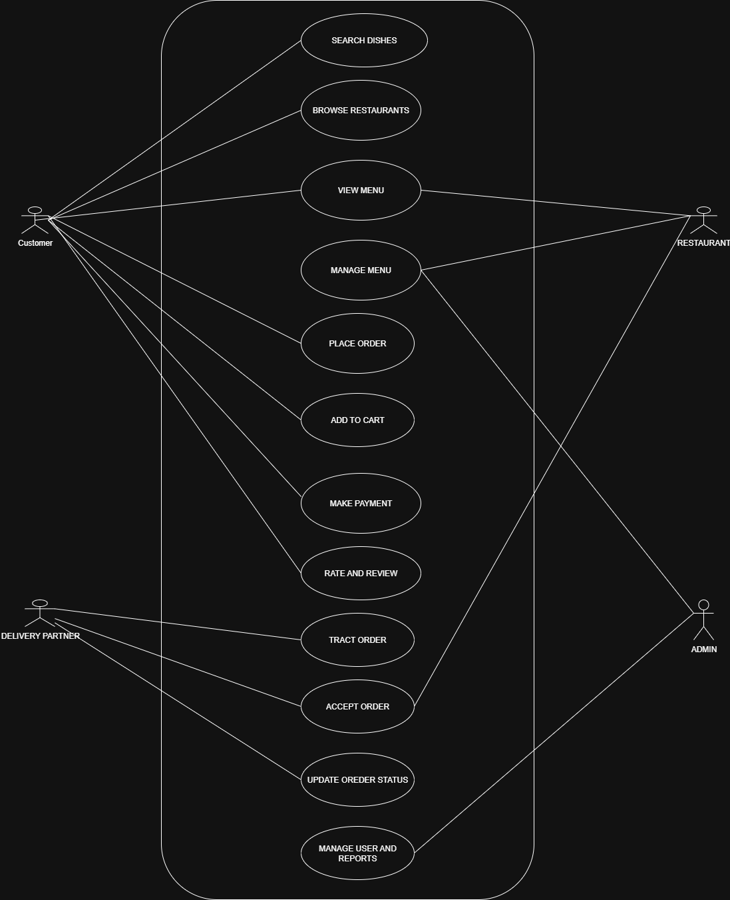
Use Case Diagram

Slide 11
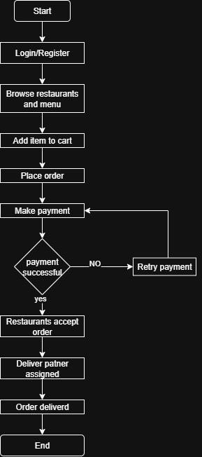
Business Process Flowchart

Slide 12
Conclusion
The Online Food Ordering App provides a centralized platform for customers, restaurants, and delivery partners, ensuring convenience, efficiency, and customer satisfaction.

